Slide 1
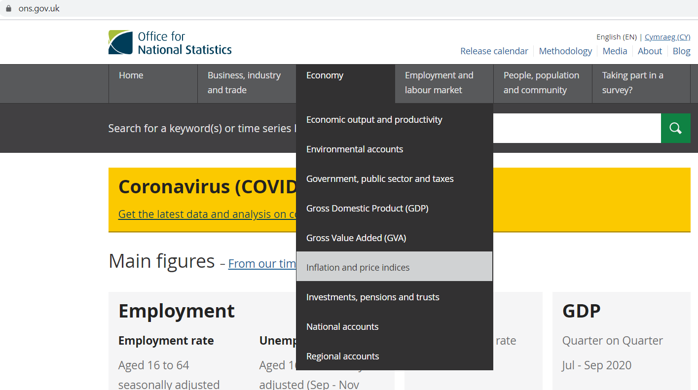
Procedure to obtain PPI data for UK
Go to :
Move your cursor to “Economy”
Select “Inflation and price indices”
https://www.ons.gov.uk/

Slide 2
Procedure to obtain PPI data for UK
Click on “Datasets”
Scroll to the bottom of the page and click on “View all datasets related to Inflation and price indices””

Slide 3
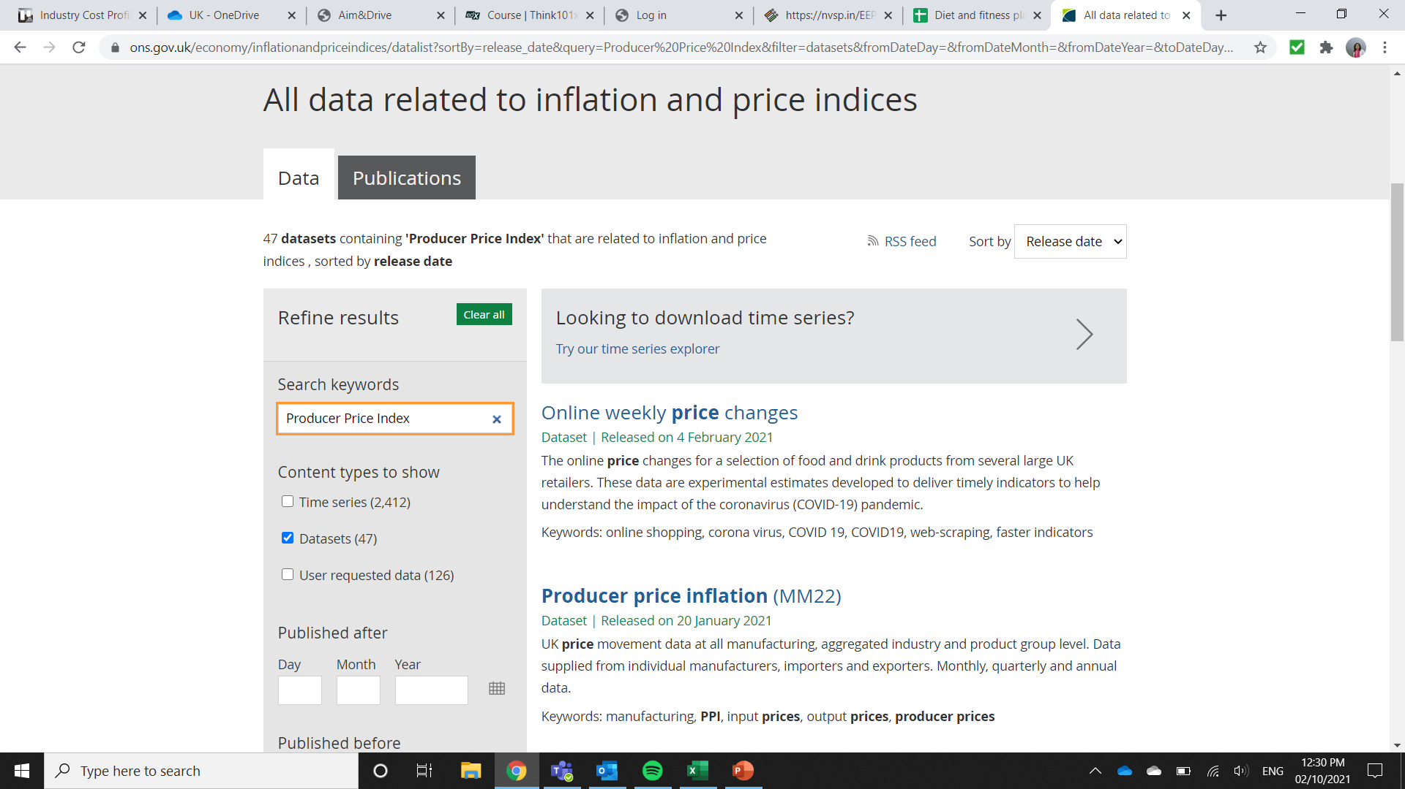
Procedure to obtain PPI data for UK
Use the search bar to find PPI data for time period of choice
Scroll to find PPI data as required

Slide 4
Procedure to obtain PPI data for UK
Download the data in Excel by clicking on “xlsx”

Slide 5
Procedure to obtain PPI data for UK
In the downloaded excel file, go to “Contents” worksheet.
Search for Table 2: Price Indices of UK Output: All Manufacturing & Selected Industries
`

Slide 6
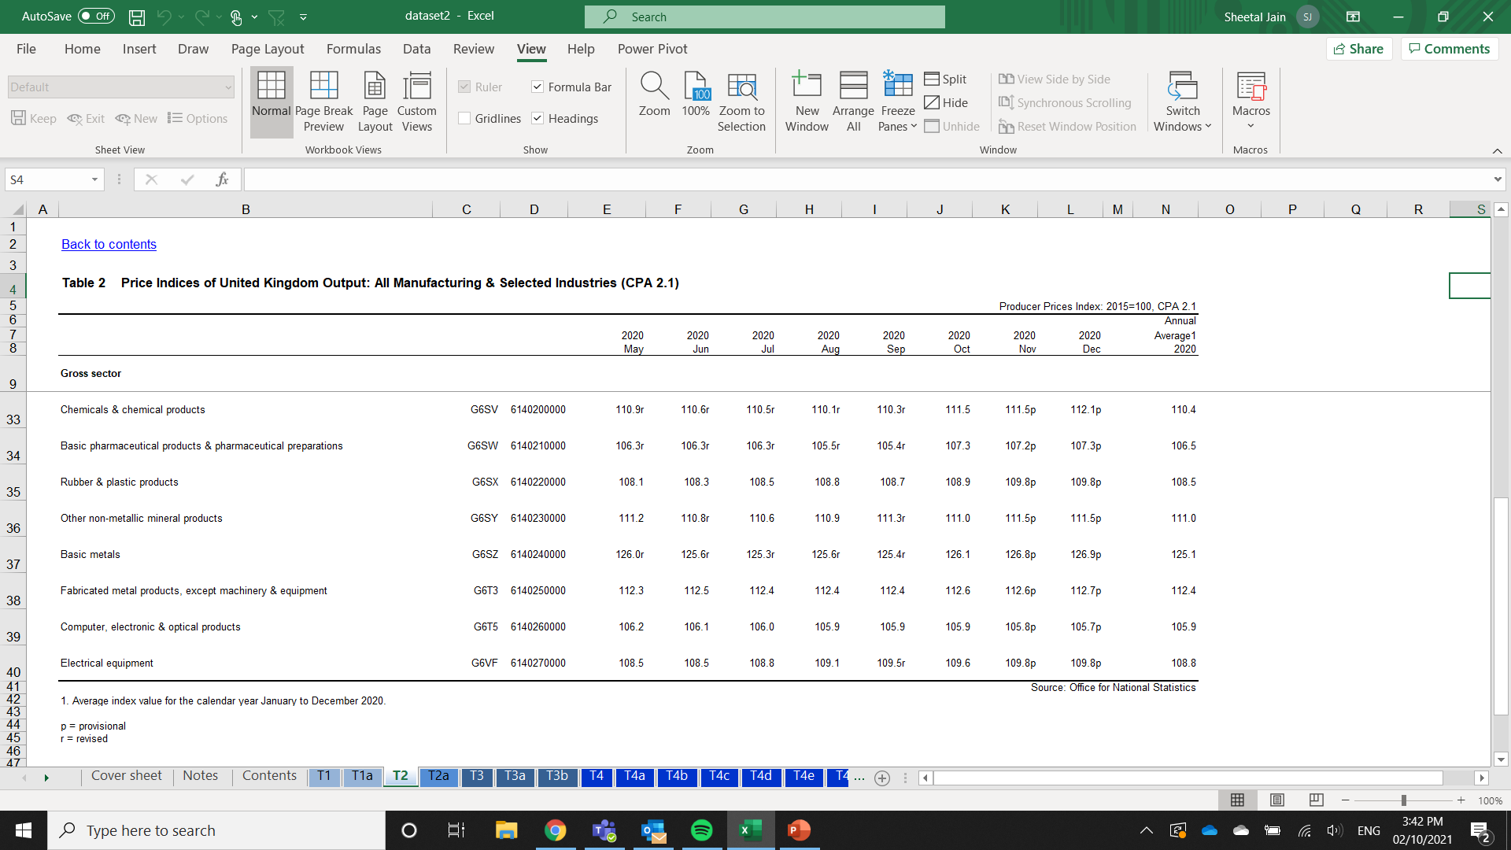
Procedure to obtain PPI data for UK
The index is displayed as shown here
Ex: Fabricated Metal Products, Except Machinery & Equipment

