Slide 1
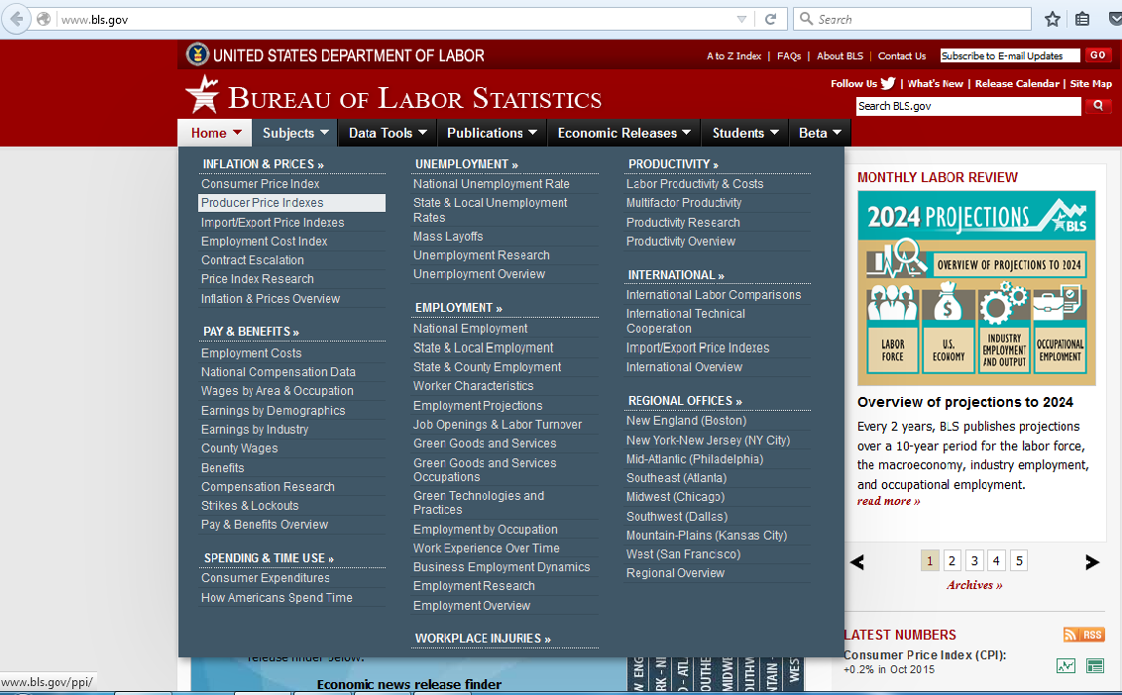
Procedure to obtain PPI data for US
Go to :
Move your cursor to “Subjects” and select “Producer Price Indexes”
https://www.bls.gov/

Slide 2
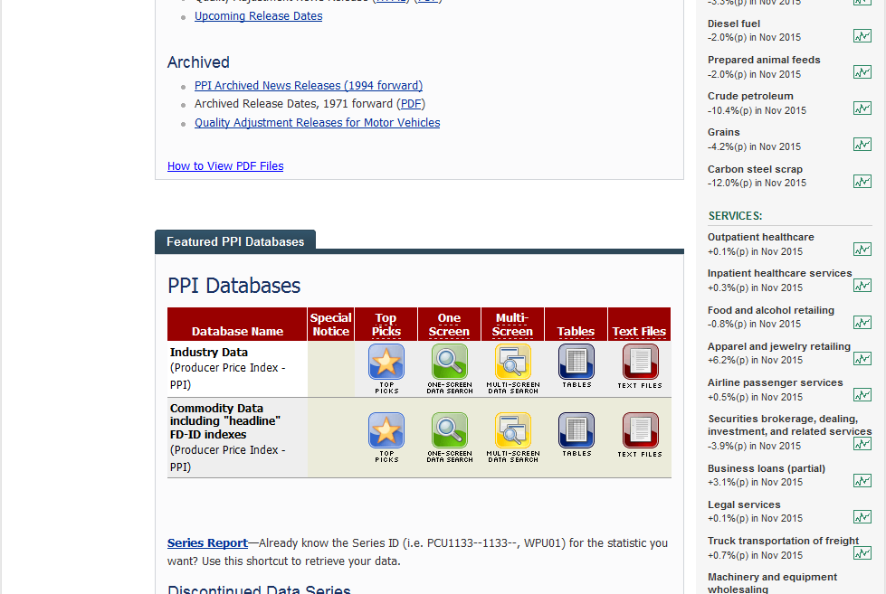
Procedure to obtain PPI data for US
Scroll Down, and look for “Featured PPI Databases”
Choose “Multi Screen Data Search” for “Industry Data”

Slide 3
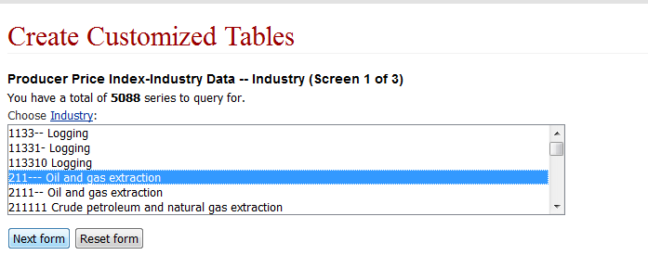
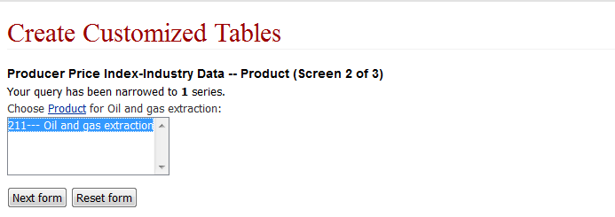
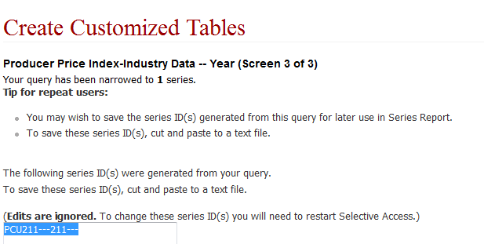
Procedure to obtain PPI data for US
Choose the required industry
Ex: Oil and Gas Extraction
Then click on “Next form”
Choose The specific product from the more Narrowed
down industry products.
Click on “Next form”
Select the code generated and click on “Retrieve data’

Slide 4
Procedure to obtain PPI data for US
The index is displayed in the following table
Data can be downloaded in excel by clicking “xlsx”

