Slide 1
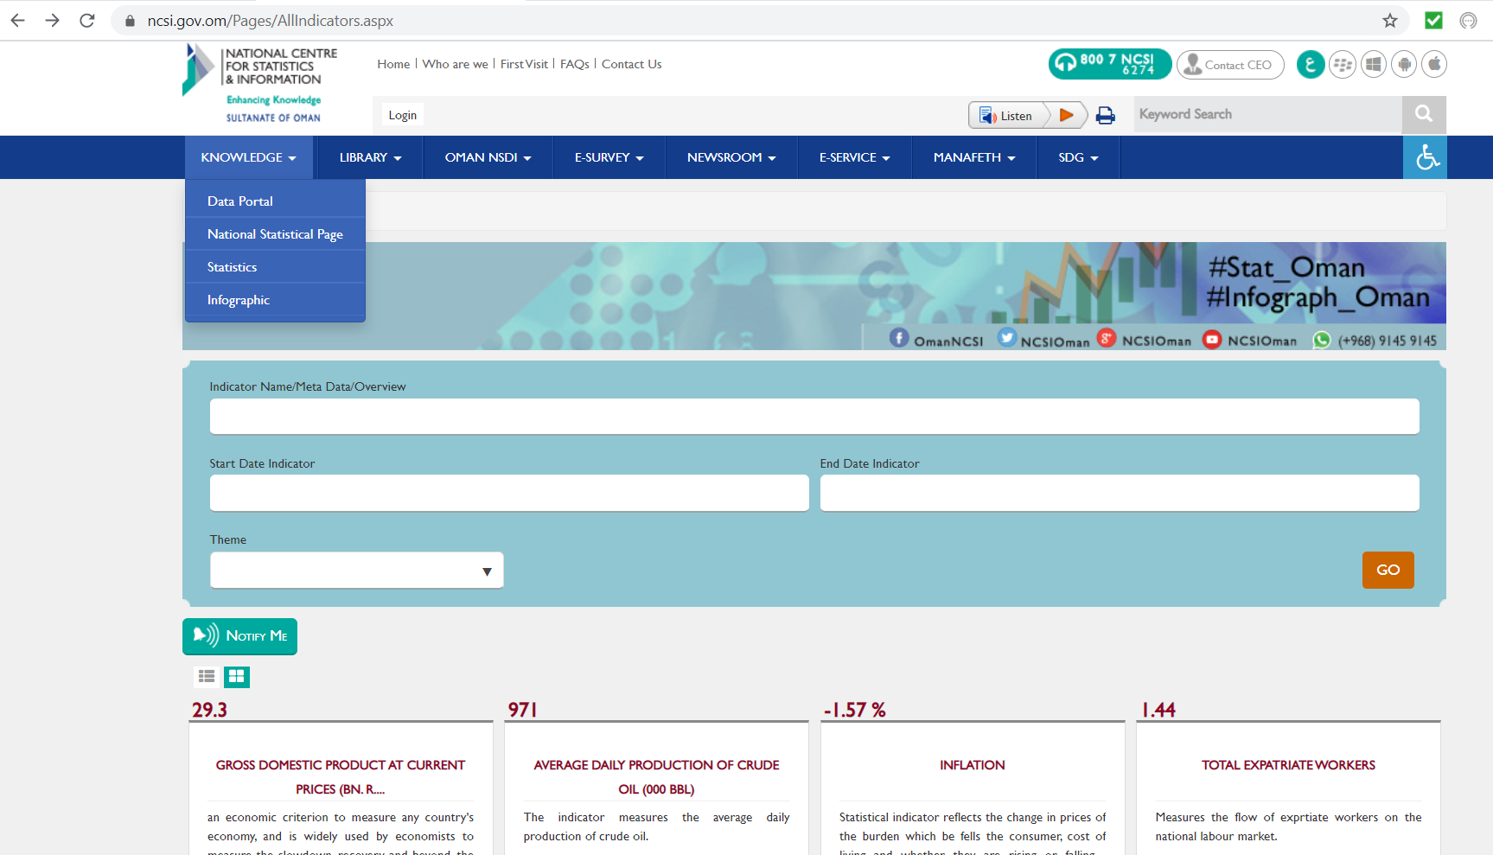
Producer Price Index
PPI
Go to
Click on “Data Portal”
https://ncsi.gov.om/Pages/AllIndicators.aspx

Slide 2
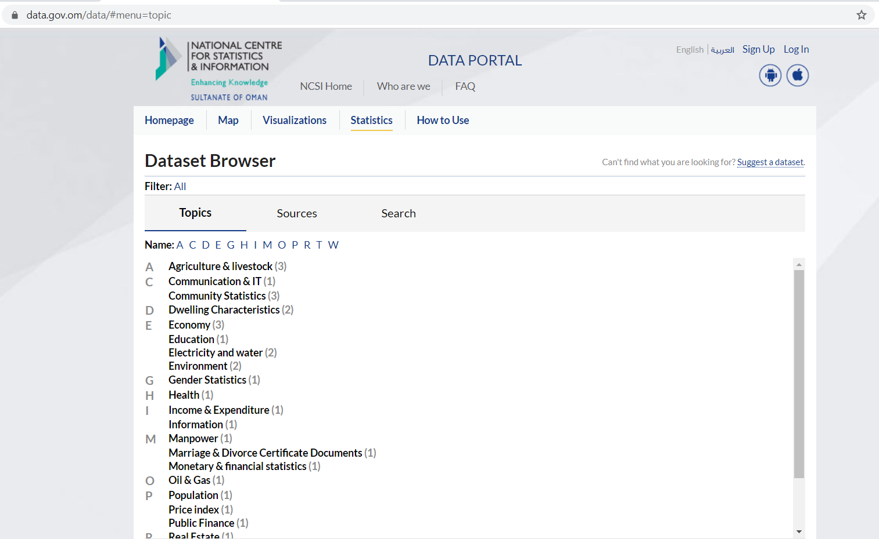
Producer Price Index
PPI
Click on “Statistics”
Click on “Price Index”

Slide 3
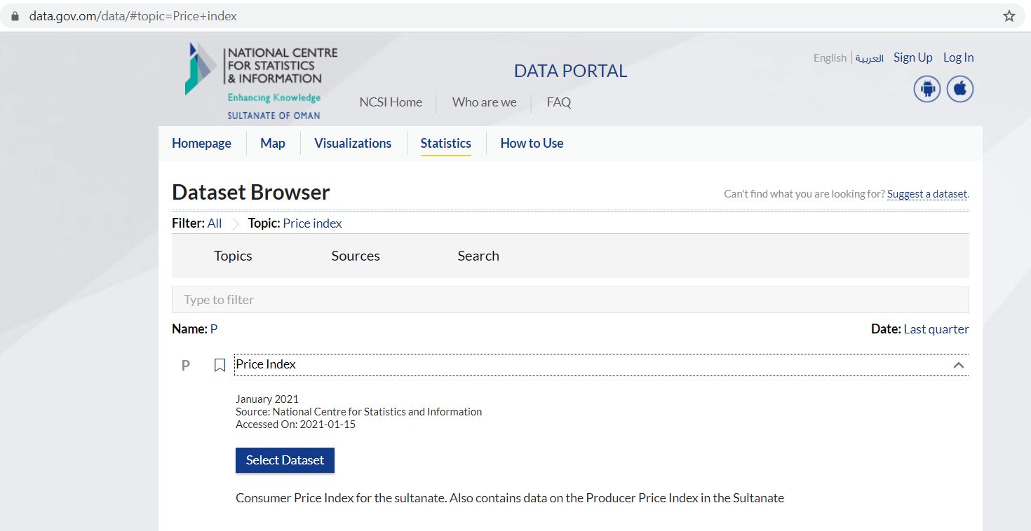
Producer Price Index
PPI
Click on “Price Index”
Click on “Select Dataset”

Slide 4
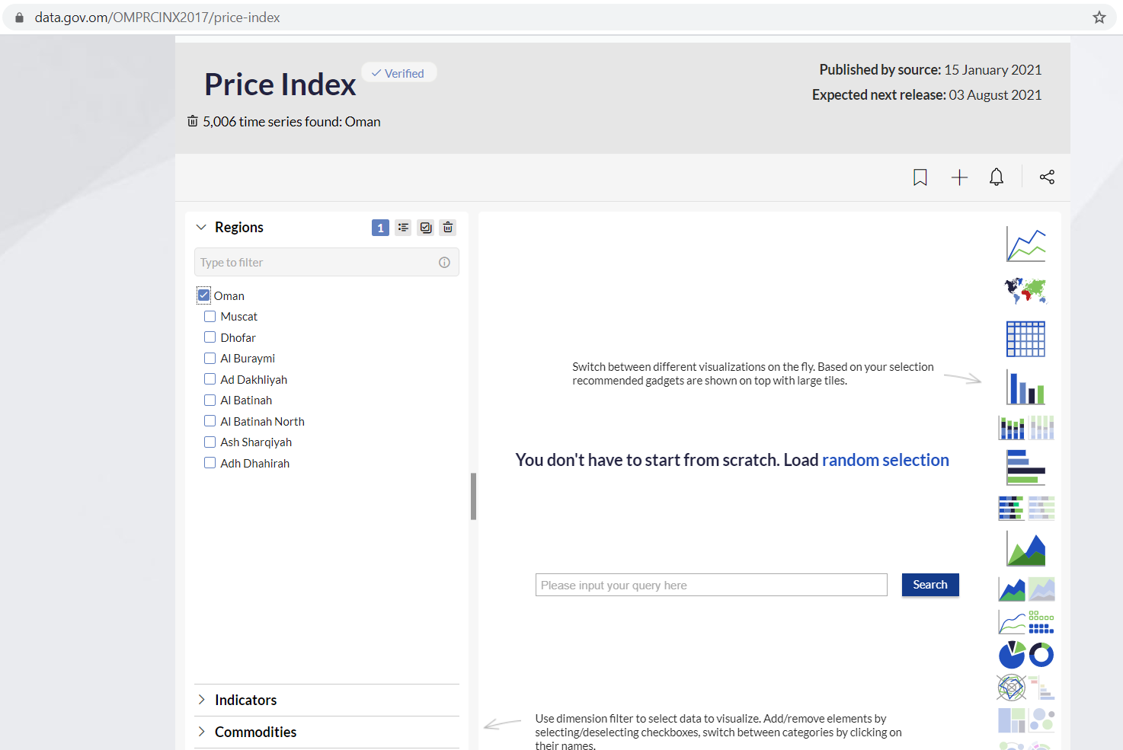
Producer Price Index
PPI
Under “Regions” select “Oman”

Slide 5
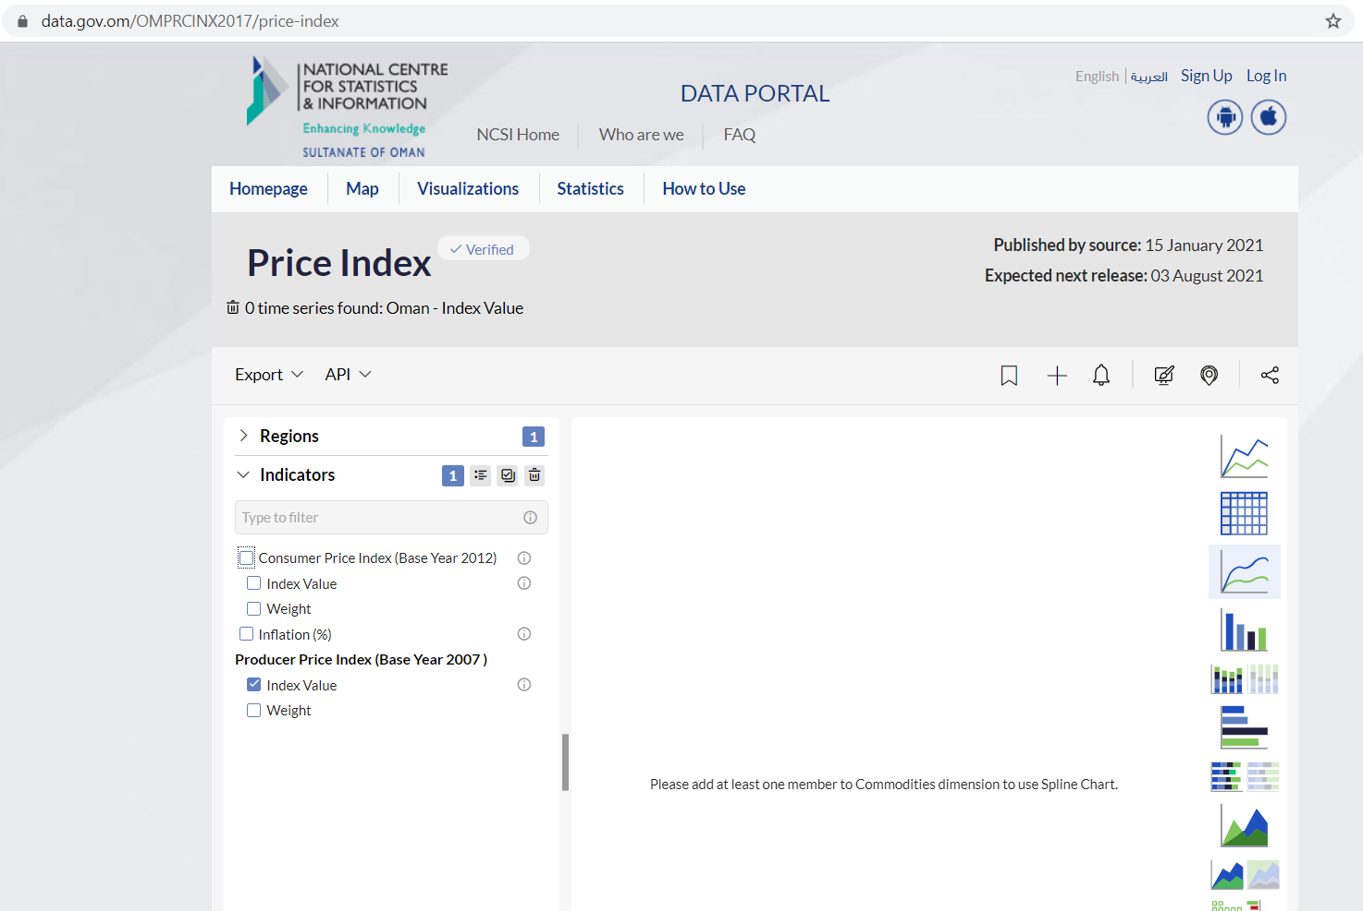
Producer Price Index
PPI
Under “Indicators” select “Producer Price Index: Index Value”

Slide 6
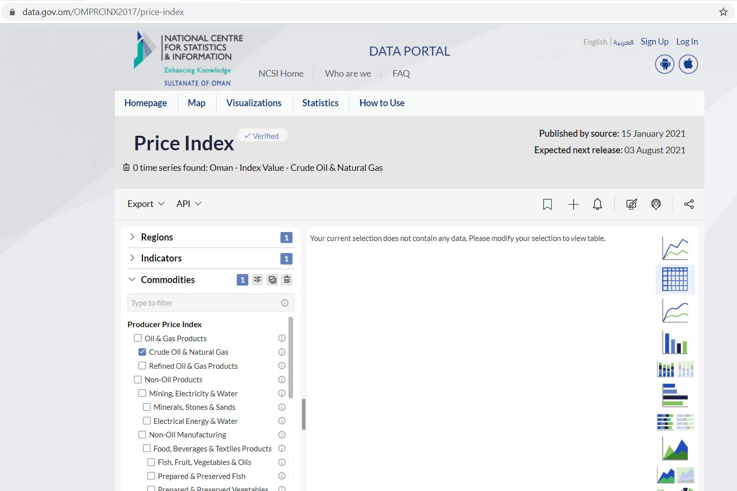
Producer Price Index
PPI
Under “Commodities” scroll through the list select the commodity of interest

Slide 7
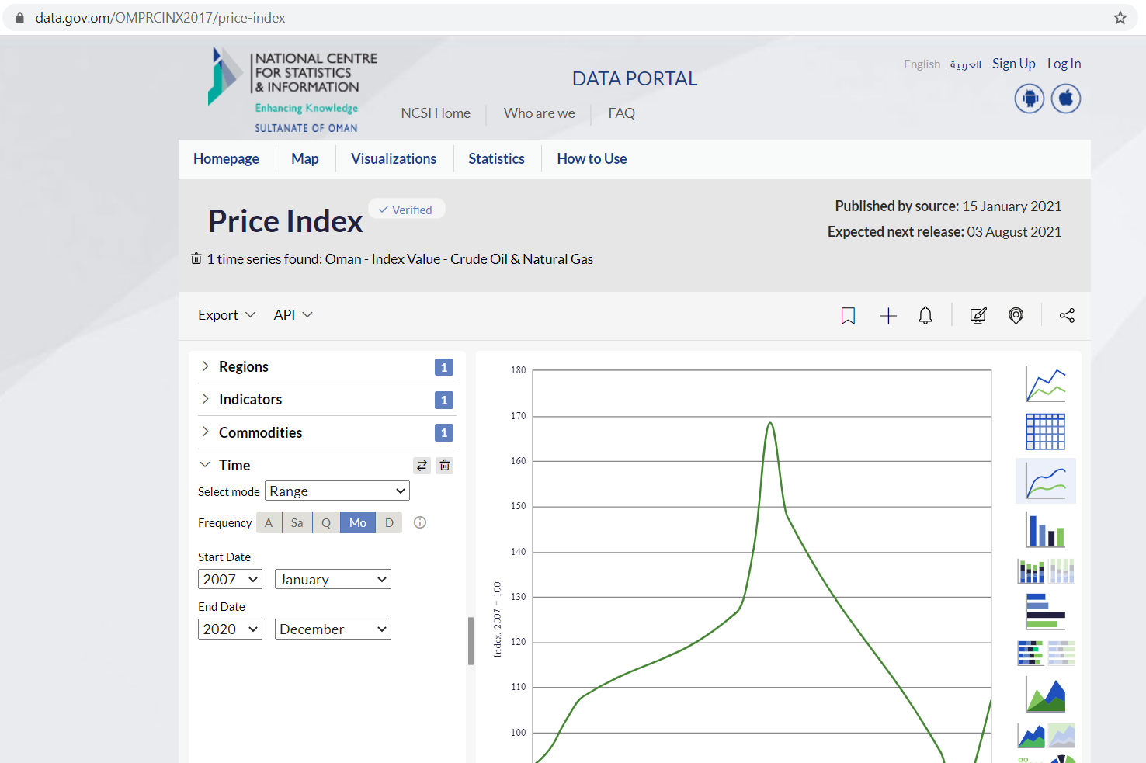
Producer Price Index
PPI
Under “Time” select the desired time range

Slide 8
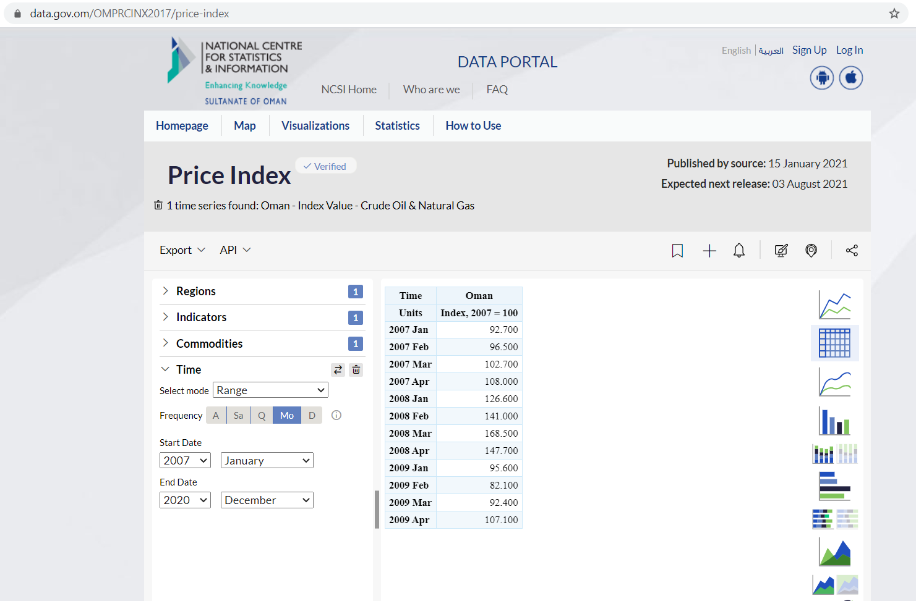
Producer Price Index
PPI
Click on the Table structure on the right-hand side to obtain data in a Table view

