Slide 1
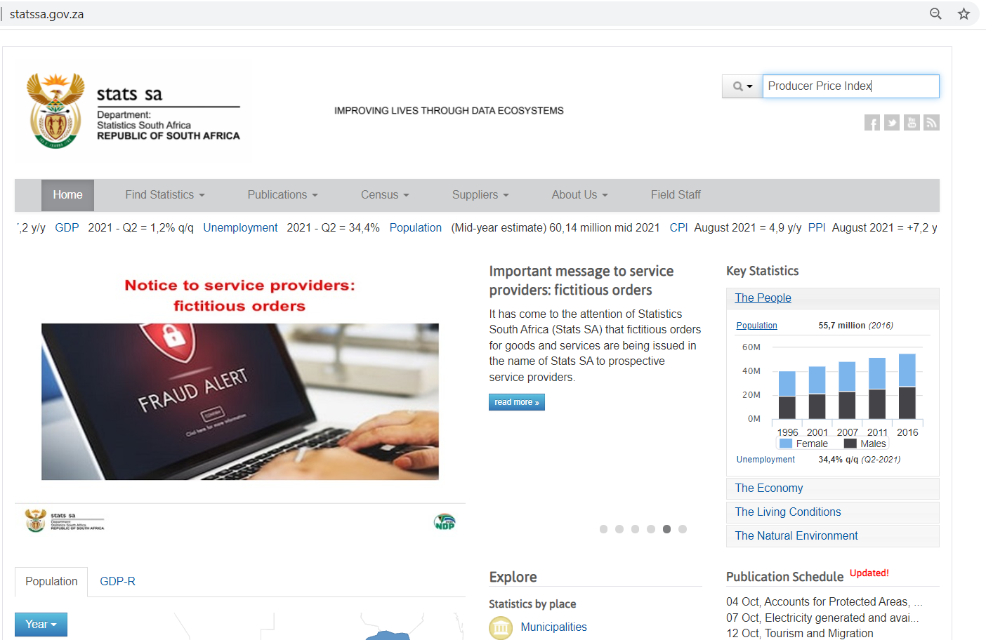
Procedure to obtain PPI data for South Africa
Go to:
Type “Producer Price Index” in the Search bar at the top right corner
http://www.statssa.gov.za/

Slide 2
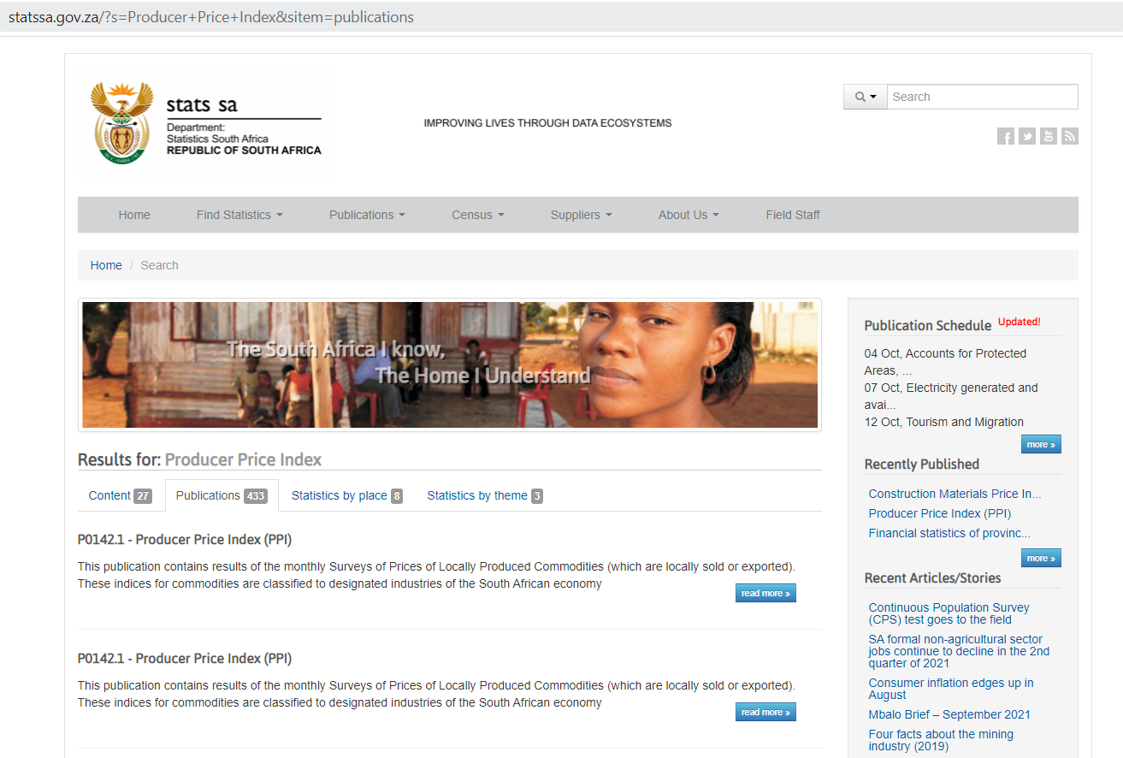
Procedure to obtain PPI data for South Africa
Select “P0142.1 Producer Price Index (PPI)”

Slide 3
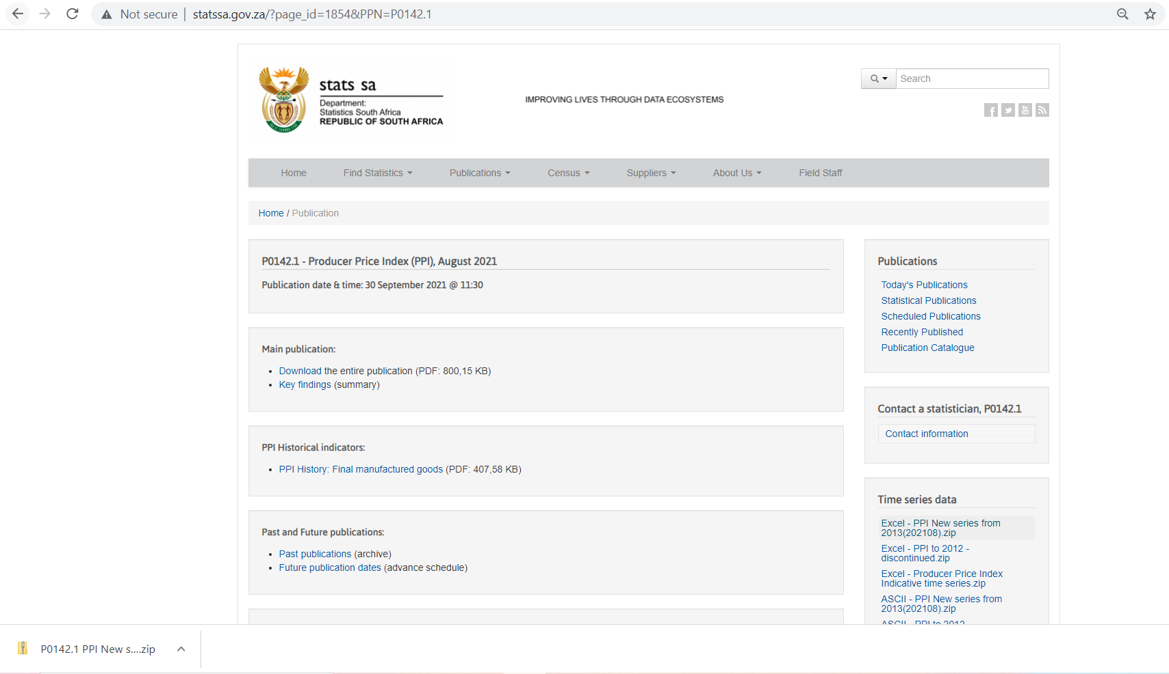
Procedure to obtain PPI data for South Africa
Download the zip file titled “Excel- PPI New series from 2013(202108).zip”
Open the zip file that gets downloaded

Slide 4
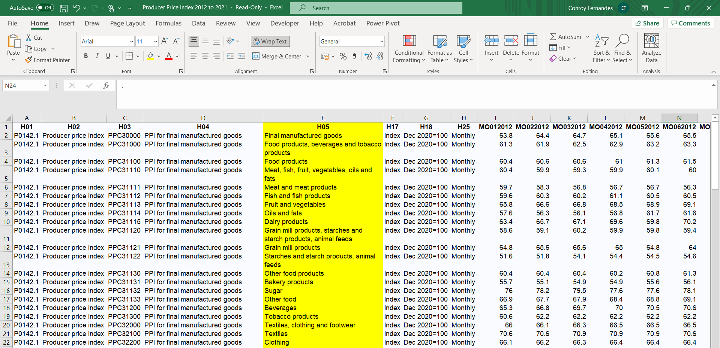
Procedure to obtain PPI data for South Africa
Open the Excel file titled “Producer Price index 2012 to 2021”
The Excel file downloaded contains PPI data for “Final Manufactured Goods” reported MONTHLY from 2012 to the most recent month in 2021.
Column E contains the “Industry name” variable that can be used to find the data for the industry of interest.

